Slide 1

Statistical Machine Learning…
“Our INTELLIGENCE is what makes
  us human , and AI is an extension of that
  QUALITY”…
Name : P . Neha
Hall Ticket No: 2203A52168

Slide 2
Trainer:
MR . D. Ramesh
Asst. Professor
CSE (AI&ML)
TRAINER:
MR . D. RAMESH
Asst. Professor
CSE (AI&ML)

Slide 3
Problem Statement:
Develop a project to predict the outcome whether the person is diabetic or not by considering the following factors like Age, Glucose level , BMI, Skin Thickness, Blood pressure, Diabetes pedigree function, Insulin

Slide 4
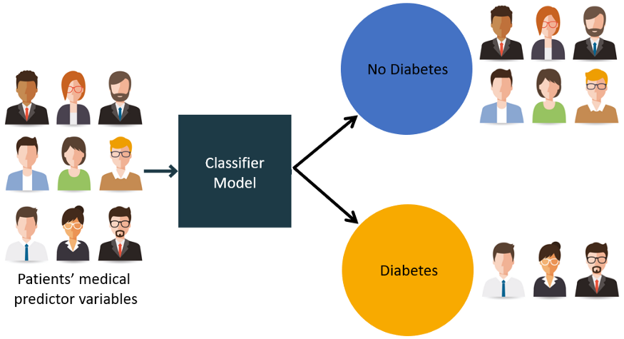
Introduction:-
The data set I have chosen is diabetes this data set consists of :
Pregnancies
Glucose
Blood Pressure
Skin Thickness
Insulin
BMI
Diabetes Pedigree Function
Age
Outcome (diabetic or not)
** Each factor is going to effect the diabetic condition of the person

Slide 5
The Data set is readily available on the internet, the link follows:
https://www.kaggle.com/datasets/mathchi/diabetes-data-set
The data set consists of (768 rows * 9 columns). It holds 768 persons Information.
The data is in numerical form so no need to covert the strings into Numerical Form, So to make further process easy the min max scaling should be done it makes the whole data into 0’s and 1’s. This Process is also known as Normalisation .
The First Step is selecting the min value form the data set and the max value from the data set. There exists a Formula for the Calculation :
Where A is a value which is not constant, it varies for every data in a dataset

Slide 6
The Dataset is further divided in to regression or classification. Based upon the output it is
Going to decide whether the data is regression or classification.
If the target values are continuous then it is regression.
If the target values are repeating then it is classification.
Now coming to my project my data set comes under classification.
In this project I’m going to apply :
Logistic Regression
Perceptron
SVM (for Classification)
K-nearest neighbor(for classification)
It consists of these 3 steps. To proceed these steps the splitting of the data should be done. It makes data into 2 pieces training and testing.
The presentation of the data is given in the next slide….

Slide 7
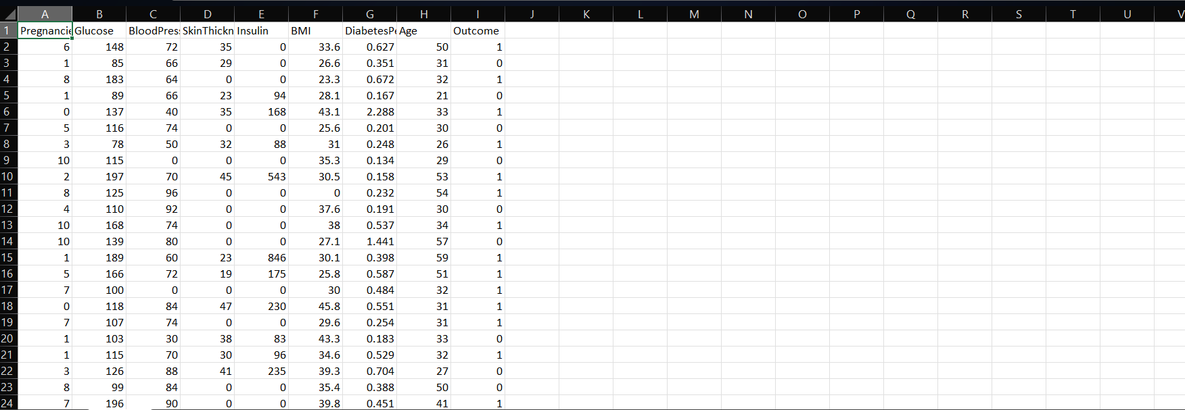

Slide 8
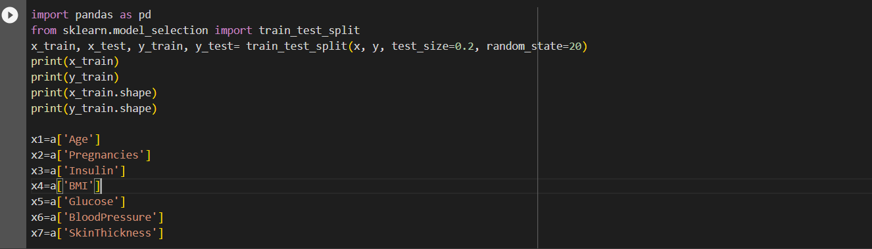
Implementation:
The Data splitting is done into training and testing .
This can be done by providing library it is available readily by using that library the splitting is done as shown below:
The test size should be given according to the no of rows and columns

Slide 9
Step 1:
Logistic Regression:
Logistic regression is a process of modeling the probability of a discrete outcome given an input variable. The most common logistic regression models a binary outcome; something that can take two values such as true/false, yes/no, and so on.
A logistic regression model predicts a dependent data variable by analyzing the relationship between one or more existing independent variables.
In this process it predicts the data , and at the end of the process it gives result as accuracy.

Slide 10
Step 2:
Perceptron
In machine learning, the perceptron (or McCulloch-Pitts neuron) is an algorithm for supervised learning of binary classifiers. A binary classifier is a function which can decide whether or not an input, represented by a vector of numbers, belongs to some specific class.^{[1]} It is a type of linear classifier, i.e. a classification algorithm that makes its predictions based on a linear predictor function combining a set of weights with the feature vector.
Input Nodes or Input Layer:
This is the primary component of Perceptron which accepts the initial data into the system for further processing. Each input node contains a real numerical value.
Wight and Bias:
Weight parameter represents the strength of the connection between units. This is another most important parameter of Perceptron components. Weight is directly proportional to the strength of the associated input neuron in deciding the output. Further, Bias can be considered as the line of intercept in a linear equation.

Slide 11
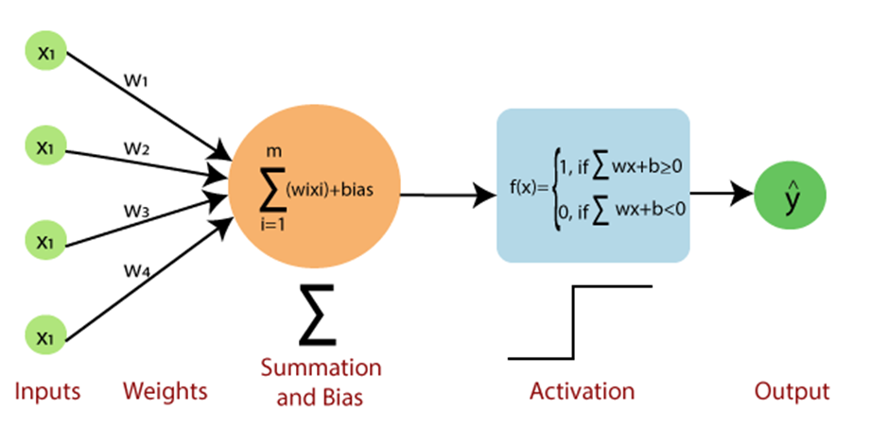
Activation Function:
These are the final and important components that help to determine whether the neuron will fire or not. Activation Function can be considered primarily as a step function.
How does Perceptron work?

Slide 12
Step-1
In the first step first, multiply all input values with corresponding weight values and then add them to determine the weighted sum. Mathematically, we can calculate the weighted sum as follows:
∑wi*xi = x1*w1 + x2*w2 +…wn*xn
Step-2
In the second step, an activation function is applied with the above-mentioned weighted sum, which gives us output either in binary form or a continuous value as follows:
Y = f(∑wi*xi + b)
Step 3:
Support Vector Machine
Support Vector Machine (SVM) is a supervised machine learning algorithm used for both classification and regression. Though we say regression problems as well it’s best suited for classification. The main objective of the SVM algorithm is to find the optimal hyperplane in an N-dimensional space that can separate the data points in different classes in the feature space. The hyperplane tries that the margin between the closest points of different classes should be as maximum as possible. The dimension of the hyperplane depends upon the number of features. If the number of input features is two, then the hyperplane is just a line. If the number of input features is three, then the hyperplane becomes a 2-D plane.

Slide 13
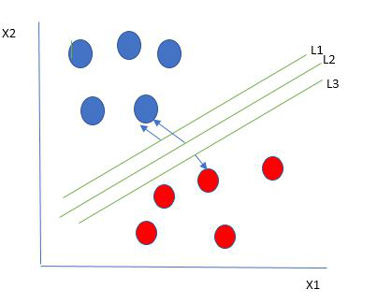
How does SVM work?
One reasonable choice as the best hyperplane is the one that represents the largest separation or margin between the two classes.
So we choose the hyperplane whose distance from it to the nearest data point on each side is maximized. If such a hyperplane exists it is known as the maximum-margin hyperplane/hard margin.

Slide 14
Step 4:
K-Nearest Neighbor(knn)
K-Nearest Neighbors (KNN) classification is a fundamental machine learning technique used for solving classification problems. In KNN, the class of a data point is determined by examining the class labels of its k-nearest neighbors within the feature space. The process involves calculating distances (e.g., Euclidean or Manhattan) between data points and selecting the k closest ones. The majority class among these neighbors is then assigned as the predicted class for the target data point. Key considerations in KNN include choosing an appropriate 'k' value, which can significantly impact the algorithm's performance—smaller 'k' values make the model more sensitive to noise, while larger 'k' values result in smoother decision boundaries.
Additionally, the choice of a suitable distance metric is crucial, and data preprocessing steps like scaling and normalization are often required. KNN is a non-parametric algorithm, making no assumptions about data distribution. It is easy to understand and implement, making it a good starting point for classification tasks. However, it can be computationally expensive for large datasets, and its performance may suffer in high-dimensional spaces. Addressing class imbalance is also essential for KNN to yield accurate results.

Slide 15
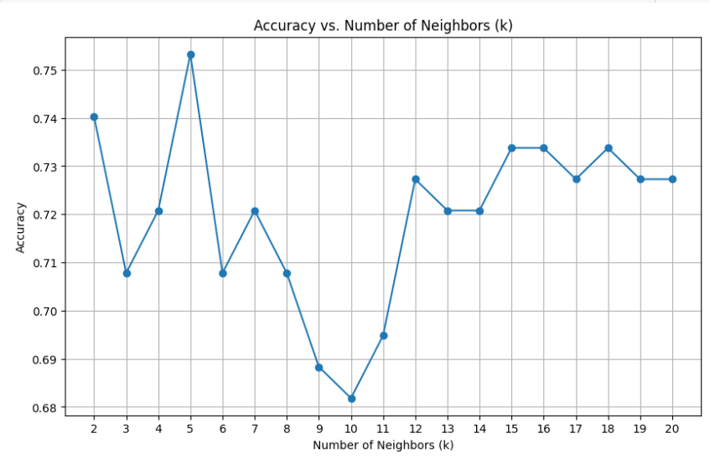
Graph Visualisation:

Slide 16
Bootstrap for above algorithms:
bootstrap is a statistical resampling method used for estimating the uncertainty of sample statistics or model parameters. It involves repeatedly drawing random samples with replacement from a given dataset to create numerous resamples. By calculating statistics on these resamples, it provides insights into the distribution of the statistic, allowing for confidence intervals, hypothesis testing, and uncertainty assessment. Bootstrap is particularly valuable when the underlying data distribution is unknown or complex. It is widely employed in statistics, machine learning, and data science for various applications, including model validation and improving accuracy when working with limited data.
1. Bootstrap for logistic regression:
Bootstrap resampling is useful in logistic regression for model validation, selection, and assessing parameter uncertainty. It involves repeatedly creating random subsamples from the dataset, fitting logistic regression models to these subsamples, and evaluating their performance and parameter estimates. This helps validate the model's generalization, compare different model variants, and estimate confidence intervals for model coefficients. Bootstrap is particularly beneficial when dealing with limited data or complex relationships. It aids in making logistic regression models more robust and provides a deeper understanding of their performance and parameter significance.

Slide 17
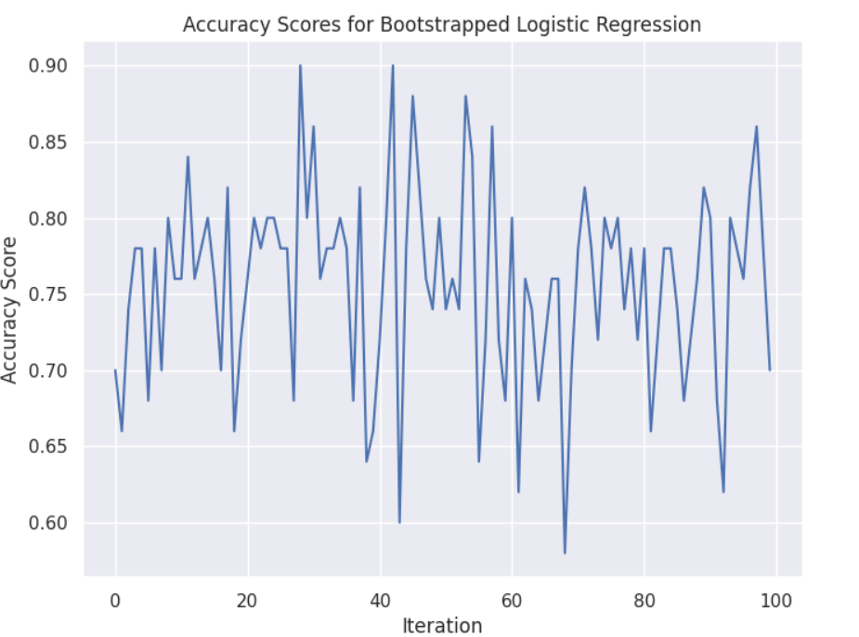

Slide 18
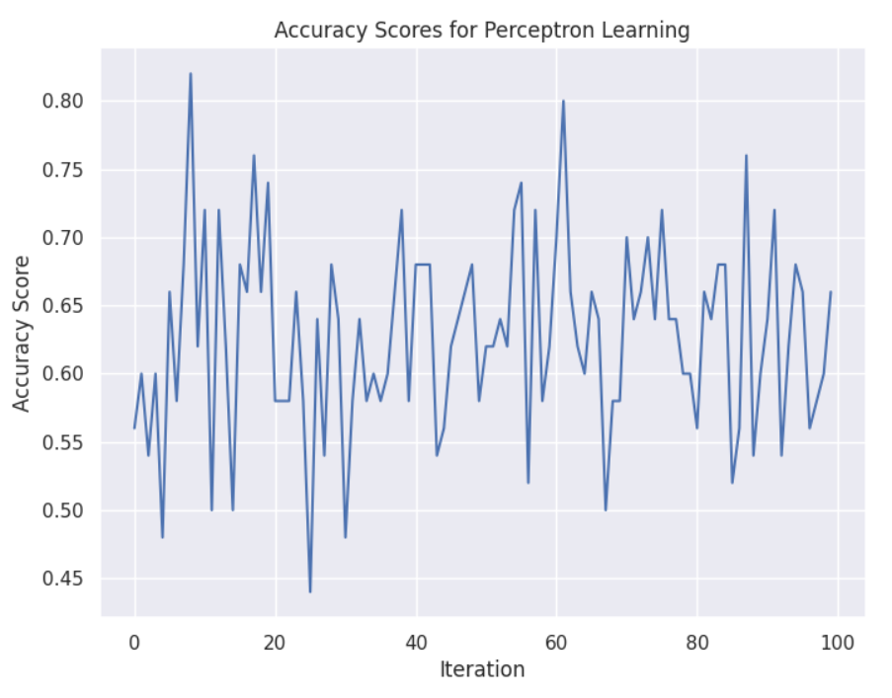
2. Bootstrap for perceptron:
Bootstrap resampling is not commonly used with the Perceptron algorithm, a simple linear classification method. Bootstrap typically benefits models involving statistical estimation. However, you can apply bootstrap for tasks like dataset subsampling to assess the Perceptron's robustness or evaluate its performance on various subsets. The primary aim is to analyze the Perceptron's behavior on different data samples rather than improving the algorithm itself. In this context, bootstrap helps understand how well the Perceptron generalizes across different data partitions and can be a useful tool for assessing its reliability in real-world scenarios.

Slide 19
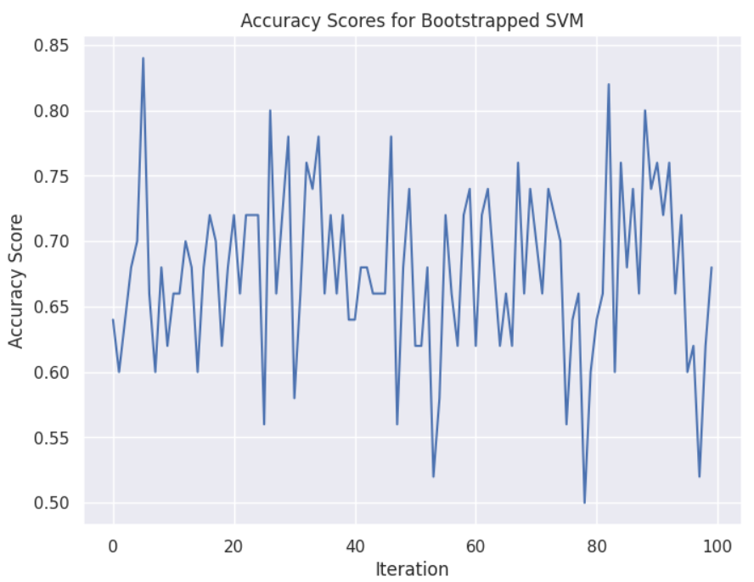
3. Bootstrap for SVM (classification):
Bootstrapping for classification is like playing a game with your data to make sure your classification model works well. You make copies of your data, shuffle them, and use each copy to check how good your model is at predicting things. This helps you know if your model is reliable. You can also use it to compare different models to see which one is better. It's like a practice game with your data to make sure your model is accurate and trustworthy.

Slide 20
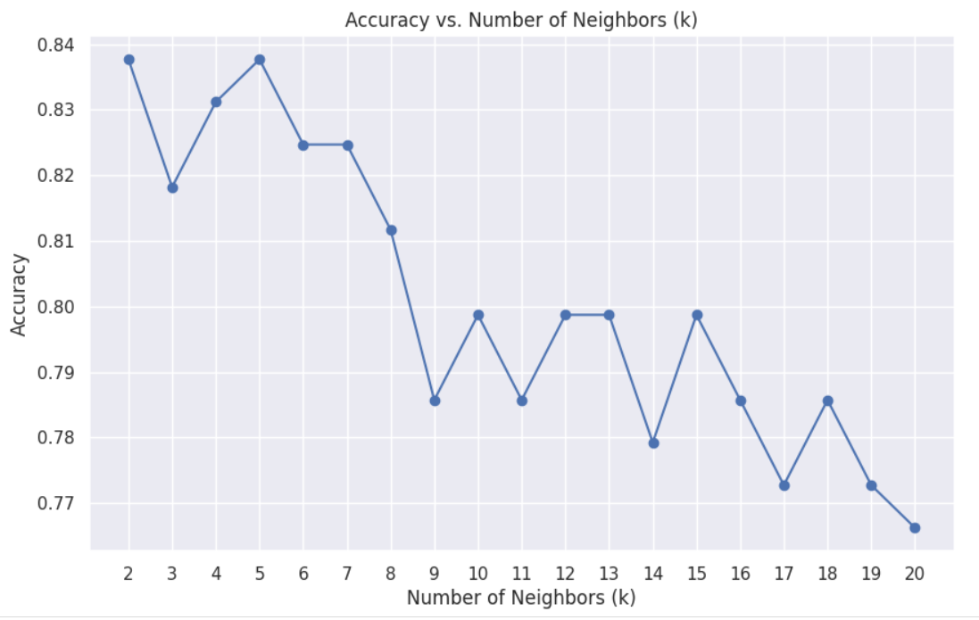
4. Bootstrap for KNN – Classification:
Bootstrap resampling is a powerful method for improving and evaluating K-Nearest Neighbors (KNN) classification models. It involves creating multiple data subsets through resampling and using them to assess the KNN model's performance. This helps validate its generalization capability, optimize the choice of 'k' (the number of neighbors), estimate confidence intervals for performance metrics, and compare KNN with other classification models. Moreover, it can be applied to assess feature importance, although KNN is not inherently suited for this. Bootstrap adds robustness to KNN classification, making it a versatile tool for model refinement and evaluation in various data analysis tasks.

Slide 21
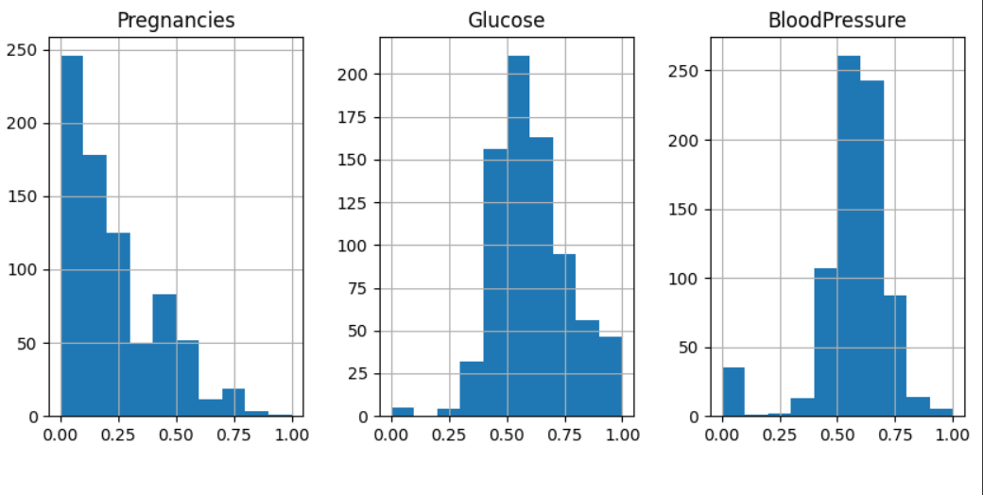
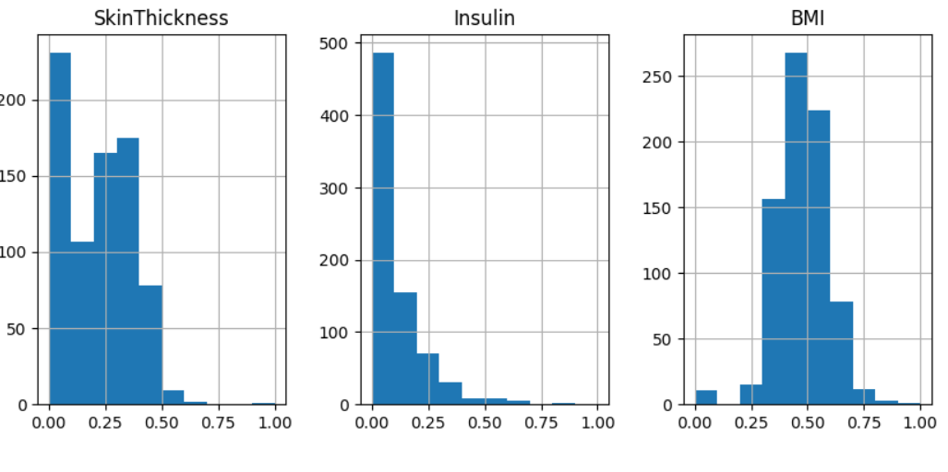
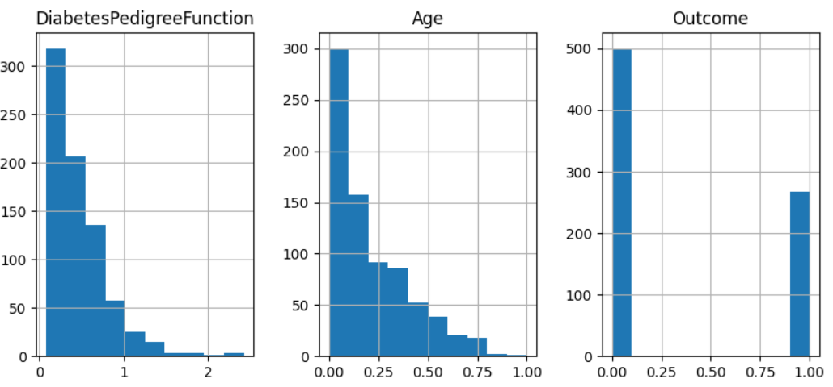
Graphs:

Slide 22
Result:
From the above applied algorithms the accuracy given by logistic regression is
0.7467% and by perceptron is 34.42% and for svm (classification) is 0.7597% and for knn-classification is 0.84% .

Slide 23
Conclusion:
The algorithm that yields the highest accuracy is considered the best fit for this dataset. For this particular dataset, KNN outperforms the other algorithms, making it the top-performing choice.
It's important to note that the best algorithm can vary for different datasets, meaning that the optimal choice may change based on the specific characteristics and requirements of each dataset.

Slide 24
GitHub Link:
https://github.com/Pakaneha/perceptron-learning

